Slide 1

Lecture Series
Business-Technology Alignment
apachory@iitgoa.ac.in
Ashish Pachory

Slide 2
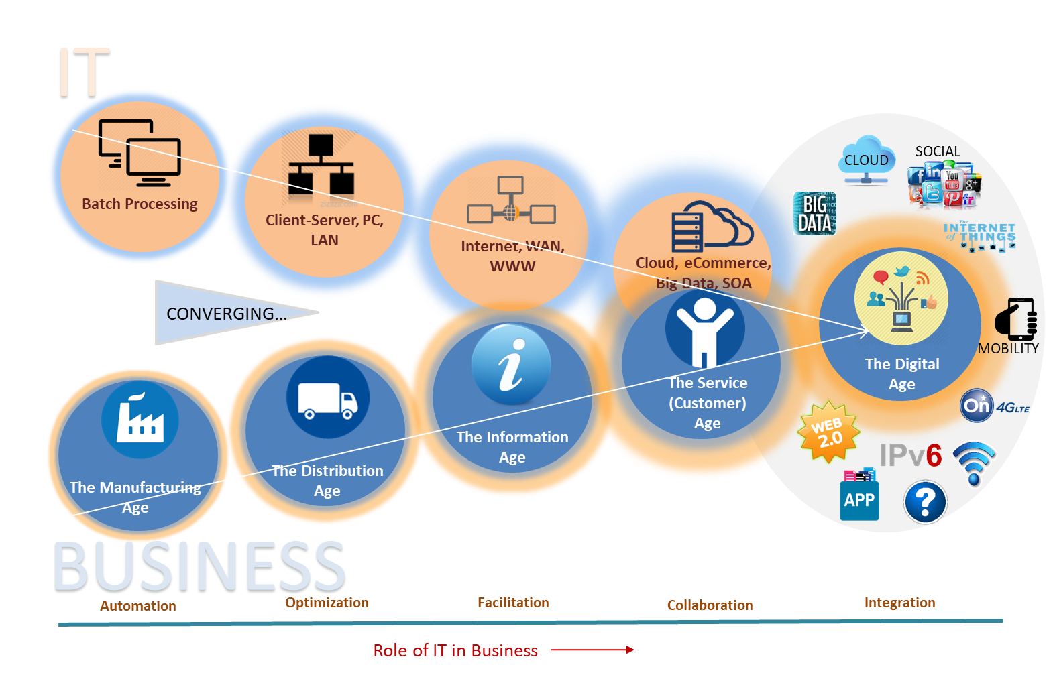
The Convergence that created the Digital Economy
Industry 1.0 [18th Century]
Steam Power, Mechanization
Industry 2.0 [19th Century]
Electricity, Railroad, Telegraph
Industry 3.0 [Mid 20th Century]
ICT, Electronics
Industry 4.0 [Today]
Advanced Robotics, 3D Printing, IoT/M2M, Digital Technology, AI and ML…
Unification
© Ashish Pachory

Slide 3
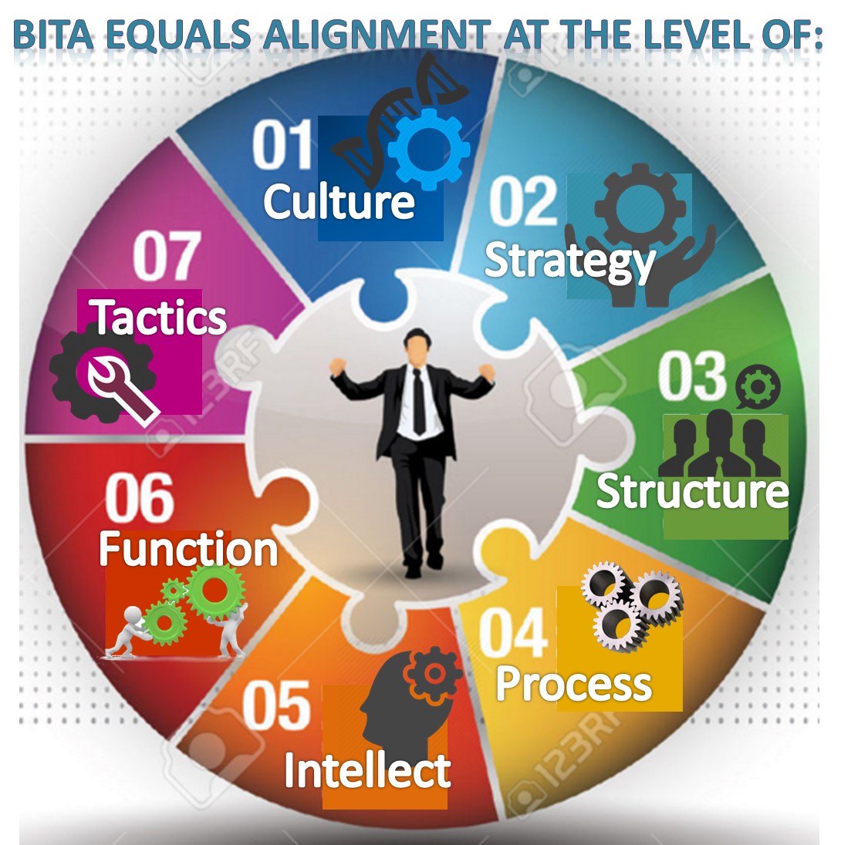


What is BITA and Why is it Critical for DX?
Business-Technology (IT) Alignment, or BITA, refers to Business and IT teams thinking, building, and operating together for a shared goal, which is to make the business successful.
THINK: Plan, Design, Share, Analyse
Business Value
BUILD: Develop, Deliver, Deploy, Optimize
BITA
OPERATE: Execute, Monitor, Secure, Support
Business Function
Technology Function
© Ashish Pachory

Slide 4

Outcome-based IT
Outcome-based model requires transition from selling what is produced to producing what can be sold.
In the outcome-based business model, the focus of the enterprise is on making the customer’s experience richer.
From a technology perspective, it requires focus on business outcomes rather than internal priorities – which have driven IT since its inception.
Outcome-based IT is a key consequence of Business-IT Alignment
Outcome-based model is a pre-requisite of Digital Transformation

Slide 5
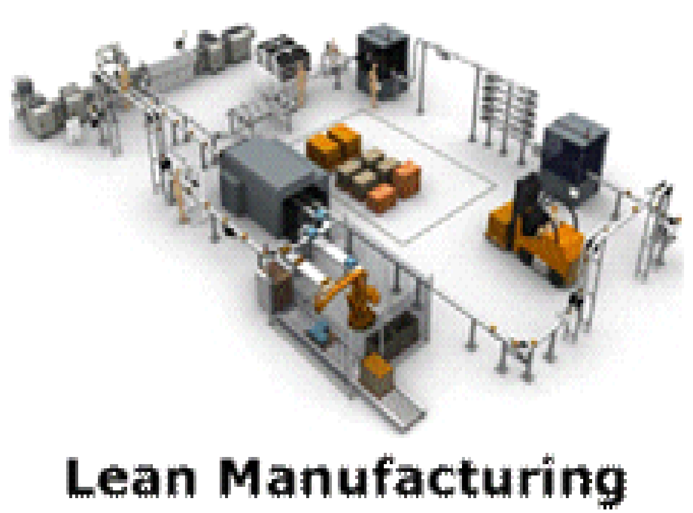



Examples of Outcome-Based IT
🗶Automation of process workflow, ERP
✔JIT Manufacturing
✔Lean Production
🗶Agency for ‘computerization’, MIS
✔Internet, mobile banking
✔Service Fulfilment
✔Secure transactions
Production
Banking
🗶Uptime of critical servers
✔Speed and Convenience
✔Customer Loyalty
✔Realtime Information
🗶’Keeping the light bulbs on’
✔Time-to-Market
✔Monetization
✔Loyalty and churn
Airlines
Telecom
© Ashish Pachory

Slide 6
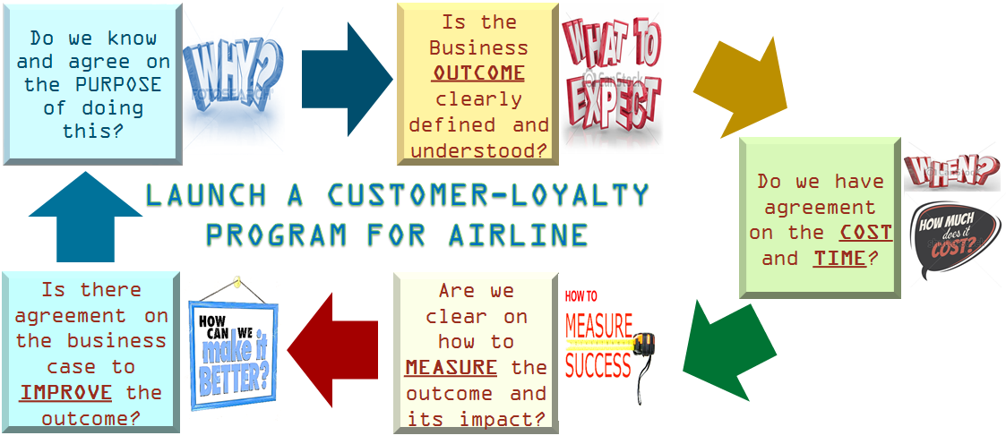
A Test for Outcome-Focus
© Ashish Pachory

Slide 7
What is IT Architecture?
B U S I N E S S
A P P L I C A T I O N
I N F O R M A T I O N
G O V E R N A N C E
C OMM N .
I N T E R F A C E
S O F T W A R E
(Dev)
F U T U R E .
.
.
Enterprise Services (Dynamic)
Variable Elements
Next Slide
Abstraction
IT Architecture for Digital Enterprise
Foundational Platform
IT Architecture
(Scalable and Flexible)
Fixed (Common) Elements
Operating System
Computing Platform
Virtualization
Hardware

Slide 8
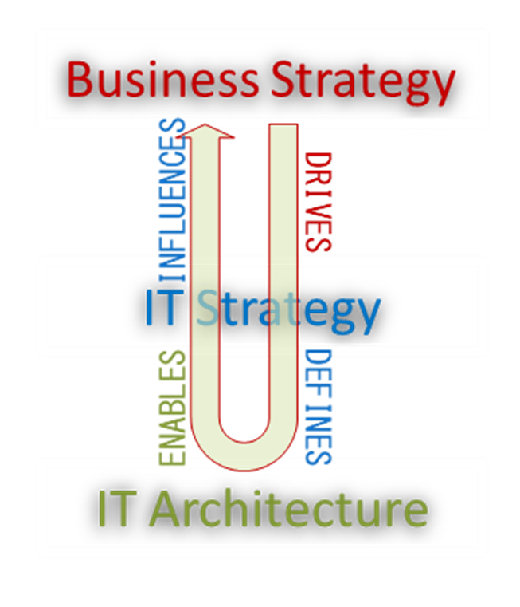
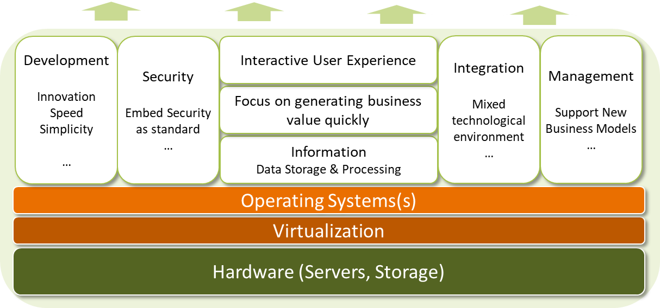
Alignment must be embedded in the Foundational Technology (Architecture)
Improve Customer Experience
Achieve Market Leadership
Increase Operational Efficiency
Globaliz-ation
Open Innovation – Co-creation
Examples of Business-Outcome driven architecture frameworks: Zachman EAI, TOGAF
© Ashish Pachory

Slide 9
Back Up …

Slide 10
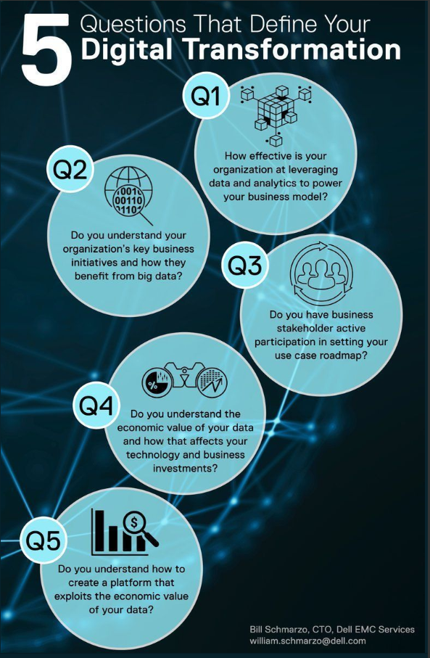
These 5 questions are crucial for enterprise Digital Transformation.
Recognizing the value of Business Data and exploiting it for economic value addition is a critical success factor for digital transformation.
Without a strong alignment between business and technology functions, it is not possible to answer any of these questions.

Slide 11
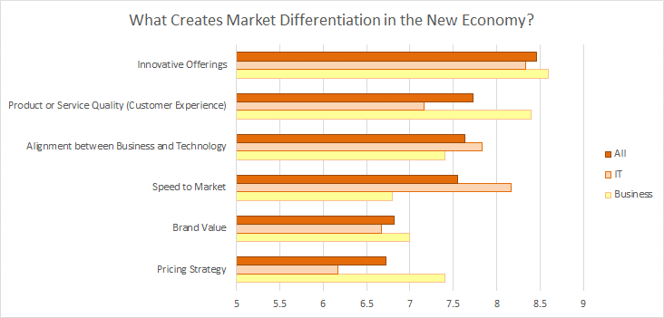

What Creates Market Differentiation in the Digital Age
© Ashish Pachory

Slide 12
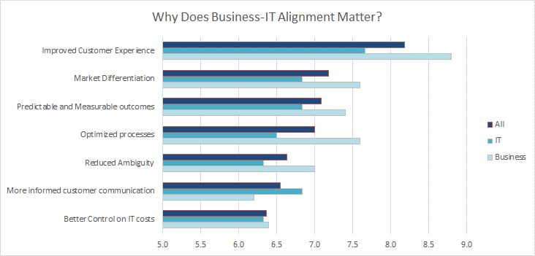

Why does Business-Technology Alignment Matter?
© Ashish Pachory

